Slide 1

SierraHiking.net
Project Review
Jason Cockroft, Russell Elliott
August 31, 2022

Slide 2
Agenda
Vision
Timeline
Platform
Internship (Russell Elliott)
Tools (Examples)
Personas: Advanced Hiker, Outdoor Professional
Walkthrough
Meeting the Needs (of the Personas)
Competitive Analysis
Future Development

Slide 3
Vison
To develop a website for thought leaders of advanced hikers and outdoor professionals
Share in depth information about trails and hiking issues and receive feedback from a like minded community
Present insights and hiking experiences (chronology/record)
Similar objective as Munro Live YouTube channel to the EV market
Success: Sacramento Bee August 24, 2024 “ … As Jason Cockroft has stated in SierraHiking.net more hikers are at risk hiking in shoulder seasons …“

Slide 4
Timeline
summer 2021
winter 2021
summer 2022
fall 2022
winter 2022
- domain
- AWS footprint
- website est.
- trail page
- master map
- landing page
- user definition
- personal history
- content dev
- dormant
- marketing plan

Slide 5


Platform
Major WP plugins:
Elementor Pro (editor)
Mapsmaker Pro
Happy Files
Really Simple SSL Pro
Akismet Anti-Spam
Wordpress 5.7.2
MySQL
25 GB storage
1 GB RAM
$ 11/mo. compute
$ 17/mo. networking
T2

Slide 6
Internship: Web Developer July-Sept. 2022
SierraHiking.net
Russell Elliott
Notes:
SierraHiking.net.
Russell Elliott. (Introduction)

Slide 7
Internship: Project Engagement
Meetings 4x per week
What we’ve done since last meeting
Other features to implement/bugs to fix
Github
Track our major assets: gpx files, API integrations, competition websites
Tutorials
Enhancement and bug tracking
Miro Board
Concept/vision development
Mockup of hiking page and master map
Wireframed the website
Notes:
Project Engagement
Jason and I meet 4 times a week. During our meetings, we discuss what we’ve done since our last meeting as well as other features are to be implemented next.
We used a Github repository to track the major assets of our site; those being gpx files, API integration, and competition websites. The repository also contained tutorials pertaining to instructions on various aspects of site and feature customization outside the scope of plugins.
Additionally, the repository served as a means to organize enhancements and bug tracking
We used a Miro board to outline the visual layout of the various site pages as well as the general user flow of the site.

Slide 8
Internship: Major Accomplishments
Evaluated Plugins
Map Plugin
Media File Manager
Wordpress Page Editor
Notes:
One of my major accomplishments was evaluating plugins for maps and other features for the website.
Map Plugin
One of these plugins was for maps. This was an important evaluation, as mapping is one of the most important aspects of the site.
Marker Clustering
For the map, we wanted the ability for markers to cluster together when the map is zoomed out. When a user clicks a cluster, it “explodes”, revealing the markers in that area.
Marker Categorization
For the map, we also wanted the ability for markers to be categorized and filtered by their length, whether they are 1-day hikes, 3-day hikes, or 7-day hikes. Users have the ability to specify which types of hikes are displayed on the map.
We ultimately chose Maps Marker Pro to serve these purposes as well as our other needs.
Media File Manager
It became clear that we needed some sort of file manager to manage all the media files associated with the hike, such as the GPX files and pictures from the hikes.
For this plugin, we needed the ability to sort files by the hikes they pertained to. Category names were titled with the year they happened followed by the name of the hike. The hiking pages and post categories for said hike are to be categorized in that same manner.
I’ve evaluated options for different media file manager plugins. Settled on Happyfiles, as it had all the features we needed whilst being less expensive than other options.
Wordpress Page Editor
Another plugin that needed evaluation was the page editor. With the modifications we wanted to do to the site, the vanilla Wordpress page editor was simply not sufficient. We ultimately chose Elementor, as that page editor had more features and had many tutorials across the internet.

Slide 9
Internship: Major Accomplishments (cont.)
Hiking Page
Evaluated best topo maps
Customized markers
Professional-looking legends
Export functions
Master Map
3 layers: 1-day, 4-day, 7-day
Developed legends
Integrated markers
Marker clustering
Organized Menus
Header and footer
Notes:
Hiking Page Template
I’ve also developed a template for the hiking page.
One of my roles in developing this template was evaluating the best topal maps. As a hiking page, it made the most sense for our maps to show some sort of topography to give the users a sense of the terrain and elevation changes that the simple elevation graph at the bottom of the map can’t reflect.
Another aspect of the hiking page was the custom markers. Maps Marker Pro offers a large collection of custom markers which developers can download onto their maps. There are three types of markers on this map; pictures represented by a camera, campsites represented by a tent, and points of interest represented by an “i” marker.
For the maps, I also included various export functions which allow the user to download the trail map in a given file format.
Master Map Template
Markers were sourced through the same means as that for the Hiking Page. The hikes were put into 3 categories; 1-day hikes, 3-day hikes, and 7-day hikes. The three hiking categories had their own markers and distinct colors.
I’ve developed a legend for this map to serve as a means to identify what each marker on the master map means.
I implemented marker categorization by representing the map as 3 layers, one for each category, which enabled the categories to be filterable on the frontend.
Organized Menus
I’ve also developed the header and footer menus of the site. The header and footer are represented as menus which are native features of the Wordpress editor. From there, I used Elementor templates to make a header and footer from said menus. I’ve modified display rules so that the header turns into a hamburger menu when the user is on a mobile device, while the footer always displays all the links.

Slide 10
Internship: Major Technical Contributions
Site Layout Customization
Went beyond gooey Elementor editor; added custom CSS styling
Fixed-width left column (Hiking Page)
Customized Tables
Customized Margins
Map Customization
Markers
Customized
Filterable
Trail Customization
File Format (kml -> gpx)
Colorization and Labeling
Notes:
Major Technical Contributions
Went beyond the gooey Elementor editor and added CSS styling to fine-tune the website to what we want. (need some examples of that and how you implemented them)
Fixed-width left column (hiking page)
One example is the fixed-width column for the hiking page, which was implemented in CSS. The left column was to be a fixed width while the right column would vary in accordance to the screen size.
This was done by customizing the CSS of the two columns. The left column was given a fixed width of 600px for desktop and tablet. The right column was given a width dynamically calculated by taking the width of the site content and subtracting 600px from that. That way, the right column changes size while the left column is always the same size.
Customized tables
Another example of custom CSS I’ve implemented was the custom table for the primary tabs of the hiking page. This table had two columns, the left column being statistical information about the trail, while the right column had buttons which represented various features of the trail which were represented as buttons.
For the left column, I reduced the line spacing between the paragraphs so the table took up less space. I also added padding between the left side of the text and the border of the table.
For the buttons, I reduced their size by reducing their inner padding and font size. I also set them to not have the mouse become a pointer when hovering over them, as to not confuse the user. The buttons themselves aren’t meant to be clickable. They are just an aesthetic means of displaying data about the trail in question.
These changes were made in the global CSS for the site.
Customized margins
Another example of custom CSS I’ve implemented was custom margins.
In the hiking page, there is padding between the elements and the edges of the page as well as padding between elements themselves. All of that was achieved by going into
One way of modifying the margin is by going into that element’s edit menu and specifying the margin or column gap.
For the padding between the columns and the page edges as well as the columns themselves, this was modified by going to the column’s edit menu and specifying the column gap.
For the padding underneath the master map, this was done by going to the element’s edit menu, going to “Advanced” and specifying the bottom margin.
A notable example of this is within the primary and secondary tabs of the hiking page. These sections are scrollable and have a scrollbar on the right. However, This is due to the div housing the content extending to the scrollbar itself, which means that text can end up overlapping with it. My solution to this was adding padding to the right side of the div by going into its custom CSS, which gave space between where the div ended and where the scrollbar began.
Map Customization
Another technical contribution was the map customization.
Markers
One part of it was the markers, specifically making them customizable and filterable.
The markers were customized by giving each category their own distinct marker. The symbols on the markers were intuitive for their intended category.
The markers were made filterable by putting each category on markers on a separate map and them including them all on the master map as layers.
Also figured out how to have polylines of multiple colors on trail maps in Maps Marker Pro. This is to be used as a means to distinguish trails from one another.
Trail Customization
Another part of the map customization is the trail customization.
One aspect of this was the file format. The trails were sourced from Google Earth Pro, which exported as kml files. However, they had to be converted to gpx files to work with the Maps Marker Pro plugin. The 3rd party site we used to perform the conversion also provided elevation data to these files.
Additionally, I figured out how to colorize the trails on the map. This is done by going into the gpx file in question and specifying the color of that trail by adding it to that part of the file.
The trails themselves are labeled from code within the name tag of the given track segment.
Gave valuable input to what plugins we can use for various aspects of the site.
Evaluated options for different media file manager plugins. Settled on Happyfiles, as it had all the features we needed whilst being less expensive than other options.
Evaluated options for Wordpress site editors. Settled on Elementor, as it offered the most features, was easiest to use, and had many tutorials for various aspects of site customization.
Evaluated different mapping plugins for the site.

Slide 11
Internship: Bugs Features
Implemented 21 features
Landing page hero image
Multiple trails on a single map
Colorized Trails
Fixed 33 bugs
Removed search fields under maps
Removed social media icons
Overhauled header and footer
Fixed issue with duplicate header and footer
Notes:
Implemented 21 features (give 5 examples)
Landing Page Hero Image
One of the major features I've implemented for the site was the landing page hero image. It was very important to get the styling exactly right as this is the first page users will see. Specifically, a different image appears whenever the page is reloaded and the background image should only go as far down as the “Recent Posts” text. Images were selected to provide property contrast between the white text and the background image. Another aspect of this component was that the aspect ratio of the image must be maintained across all screen sizes. This was done by getting the image dimensions and setting the width to be the height multiplied by the aspect ratio of said image. This feature was implemented using Javascript and CSS within the “Custom Code” section of the admin menu for the Elementor editor for the site.
Multiple trails on a single map
One feature I’ve implemented into the master map was having multiple trails be displayed and selectable on the master map. This is done by merging all the individual GPX files together into a single GPX file.
By default, Maps Marker Pro has a GPX control which allows the user to select which individual trail to display. I’ve turned this control off to give space for the filter control which allows the user to select which marker categories to display. This is used in combination with having each of the marker categories in their own separate maps which are included on the master map as layers.
Colorized Trails
Another feature I’ve implemented into the master map was the colorized trails. Each of the trails are colored as a means to distinguish them from one another. This is done by directly modifying the code in the gpx file. First, you add a namespace declaration for Maps Marker Pro to the header of the GPX file. Then, to change the color of the track in question, code specifying the color must be added within the track above the track segment tag. Finally, save your changes, upload the GPX file to wordpress, and choose that file to display on the map. Hiking Page
A feature I’ve implemented for the Hiking Page was the
Fixed 33 bugs (give 5 examples)
Some bugs were able to be addressed by modifying settings within the Elementor editor, while others were addressed through more code-heavy means.
Removed search fields under maps
One bug I fixed was the search fields underneath the maps. By default, maps on Maps Marker Pro include a field where users can search for markers via a search bar to which markers following that search are displayed below. This was fixed by going into the “Maps Marker Pro” section of the Wordpress Dashboard, going to the map in question, and selecting “None” for the display settings for the Marker List.
Removed social media buttons
One bug I fixed was eliminating the social media icons on the header. I couldn’t find an obvious way to do this natively on Wordpress so I came up with my own solution. First, I went to the header and right-clicked the social media buttons. Then, I clicked “Inspect Element” to view the live source code of the site. I navigated to where the div housing the export buttons was and took note of the class name. Then, I went into the Wordpress custom code for the site and set the div to be hidden via CSS.
Overhauled header and footer
Another bug we encountered was when the hamburger menu stopped working. On the native Inspiro theme, the header turns into a hamburger menu on tablets and phones, but we wanted it so the header would only become a hamburger menu on mobile devices. After some time troubleshooting, we deduced that the theme didn’t provide enough customization for our needs. So, I used Elementor to make a header and footer for the site. The added benefit of this was that the display settings of these menus can be modified easily. The header is set to turn into a hamburger menu when the user is on a phone while the footer never does so.
Fixed issue with duplicate header/footer
Another bug we encountered was when duplicate headers and footers appeared on the site.
This bug began occurring after I’ve implemented the custom header and footer. The first solution I found online involved addressing potentially faulty jQuery, so I downloaded a plugin for that. However, the plugin didn’t solve the issue. I solved the issue by regenerating the CSS files. This is done by going into the Tools menu of the Elementor plugin in the Admin menu.

Slide 12



Personas: Advanced Hiker
Willis - 2o years experience. Track my hikes in Word file. Looking to record and share my hikes with limited group. Use Garmin & Cal Topo. Not a fan of Facebook. Wants to share routes, photos, & insights.
Ryan - Stepping up recreational hiker. 10 years experience. Mostly single night overnights, some extended weekend hikes. Want to tackle a week-long hike next summer. What trails? How should I prepare? I’m leading a group of friends. How do I prepare the group? Can a site help me communicate to the group?
Jeana - Runs a nursery in Mariposa. Has a hobby classifying Yosemite flowers. Treks with a regular group of enthusiasts to photograph and classify wildflowers. Would like to have a website to share what & where we discovered. Would like to communicate to the group before & after hike.

Slide 13



Personas: outdoor professional
Doug - Sierra Trail Guide. Offers 4 and 7 day hikes near Bishop, CA. Looking to grow his business. Has a lot of experience hiking in early and late seasons. Eager to share experiences preparing his favorite beef stroganoff camp meal as well as how to cross Bishop Creek in early spring. Looking to direct traffic to his Facebook page or email account.
Vanessa - Outdoor Equipment Designer. A hiking enthusiast that would like to reach out to the community to test and promote her ideas. Designed a new 1-lbs camp chair. Like to receive feedback on it’s practicality.
Zach - Contract CalFire Cartographer. Sells his maps to CalFire. Has own subscription based website. Worked earlier at CalFire. Has tons of insights on the struggles of fight forest fires. Would be interested in participating in discussions on wild-fires if it could drive more traffic to his site.

Slide 14
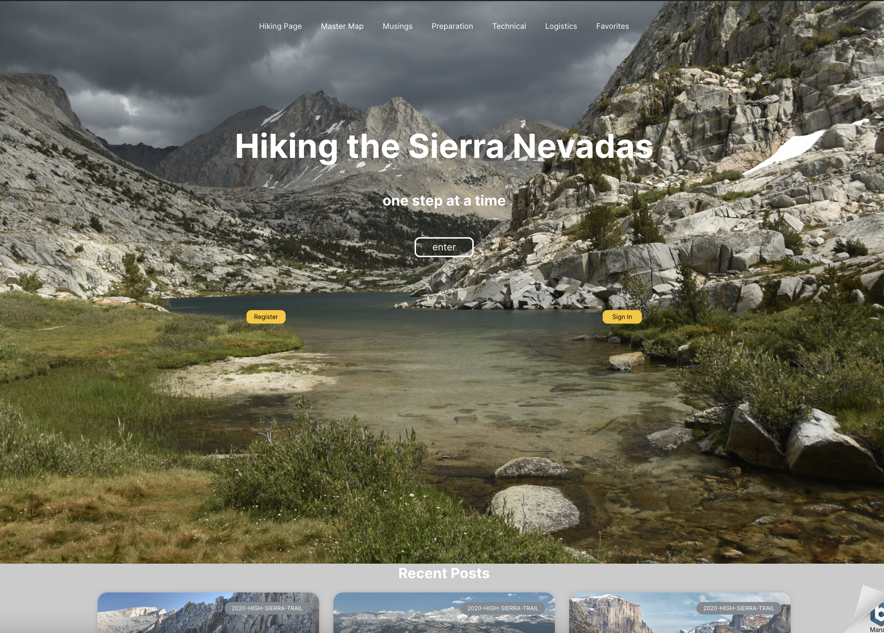
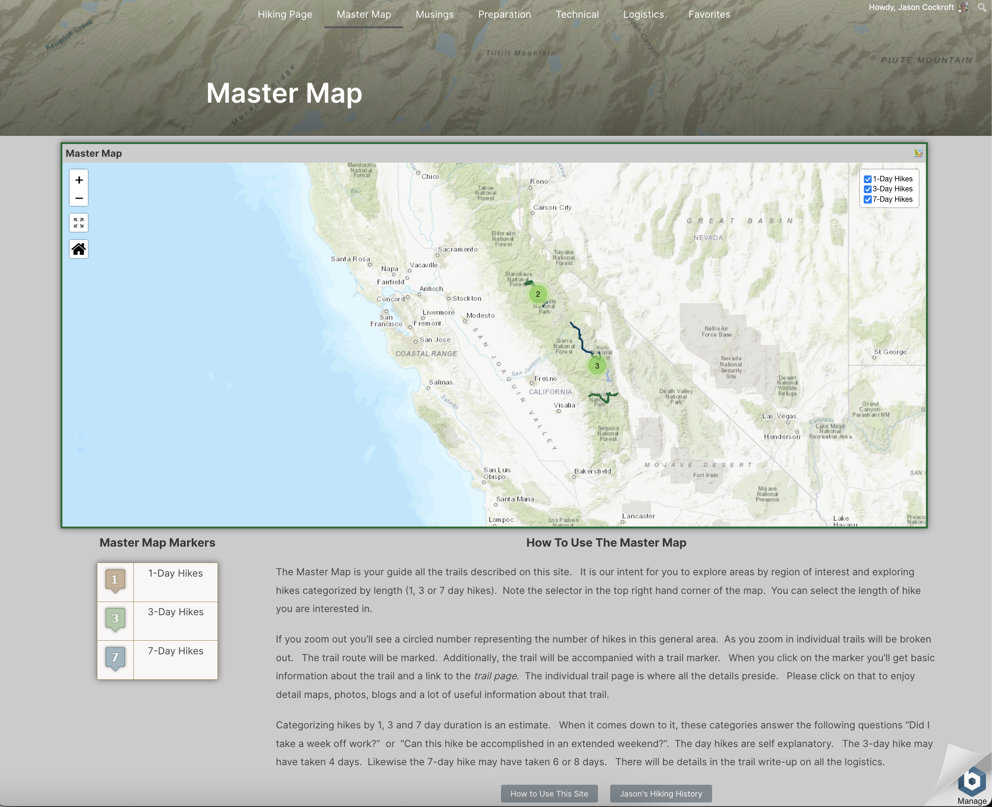
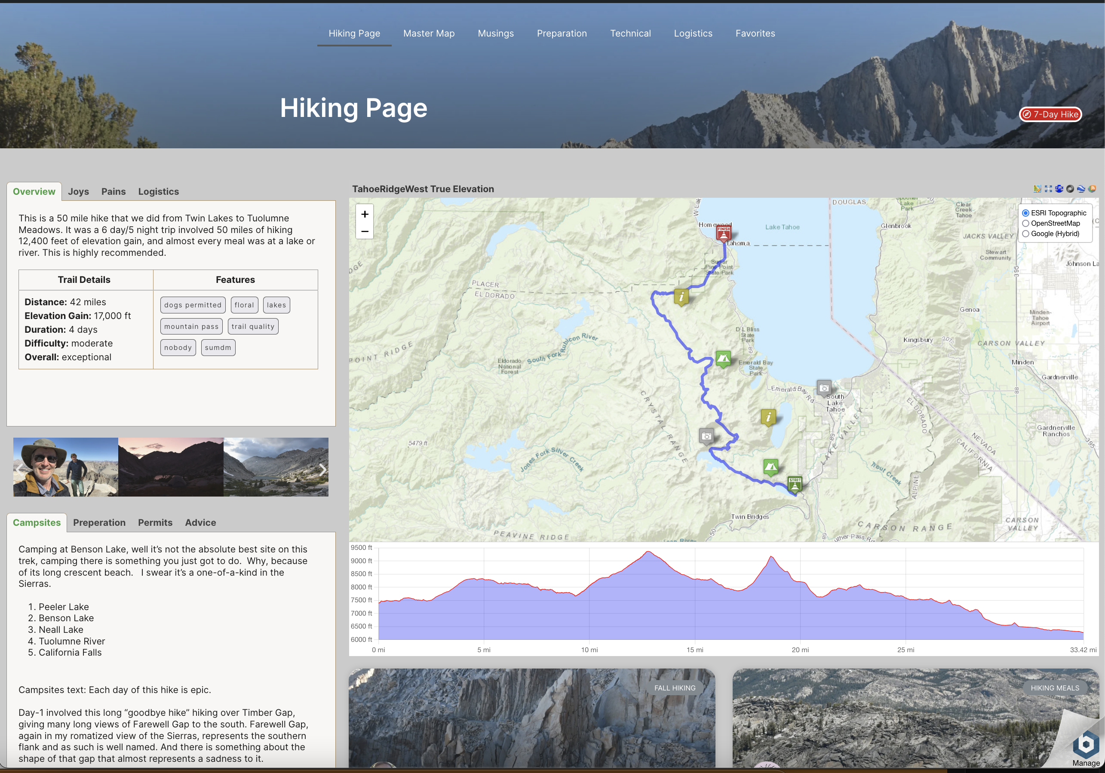
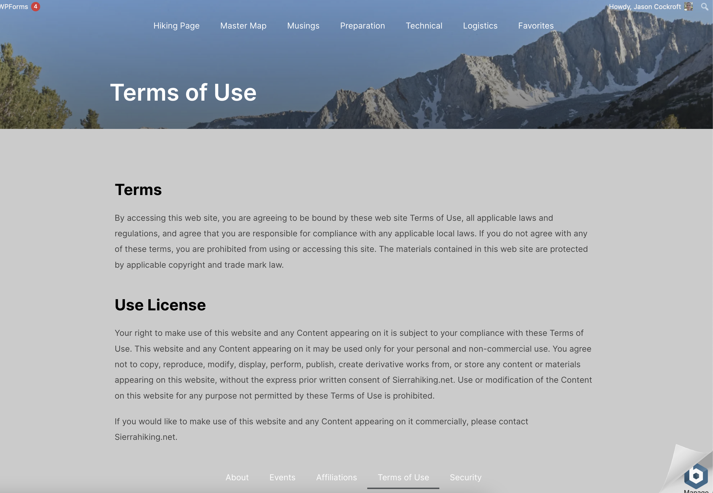
Demo: SierraHiking.net
Landing Page
Master Map
Hiking Page
Menus & Footers

Slide 15
Meeting The Needs (of the Personas)
Advanced Hikers
Personal-Private Trail Pages,: Private Posts, Media, Master Maps & Markers
Distribute new Posts to Private groups
Easy, template driven Trail Pages & Posts
Tons of useful information, engage authors
Personal-(Public) Hiking Pages: with Public Posts, Media, Master Maps & Markers
Links to Personal FB/social media pages & websites.
Offers a platform to build a brand of their expertise & services
Outdoor Professionals

Slide 16
Competitive Landscape
Navigation
Mapping Sites
strava.com
kamoot.com
gaiagps.com
alltrails.com
trailforks.com
hikingproject.com
Platforms
hikingguy.com
socalhiker.net
thehikinglife.com
Equipment
Forums
adventurealan.com
outdoorgearlab.com
www.cleverhiker.com
pcta.org
whiteblaze.net
r/WildernessBackpacking

Slide 17
The Competition
Platform | Trail Summary | Master map | Info | Strengths | Weakness
hikingguy.com | Meta data, no map, long | Marker concentration, No filters | Good Gear, skills videos, | Revenue model Concise menu Good Info | Selecting trails Feedback/social
socalhiker.net | Meta data, too many pictures, map, elevation | Localized master map, no filters | Gear review, general forums | Good moderate hiker info, moderate topics | Feels disorganized, limited info, ads-annoy
thehikinglife.com | Not concise, metadata but no map | None. | Very similar lifecycle, relevant issues | Overall, really good, organized, social tie in, good ad based revenue | Poor trail selection workflow, international only
hikespeak.com | Meta, sprawl, map | Menu driven | None | Good number of CA hikes | Trail info only. minor ads
calitrails.com | Trip report, no map, no meta | Master but no filters | None | Good trail info | Trail info only, stale, no revenue?

Slide 18
Future Development
User classification, registration, sign on, group management, page privacy
Individual hiking history
Content Development. 10 discussion-postings, 20 Trails + postings
Social Media integration
Marketing Plan + Development
User Type | 2023 | 2024
viewers | a few hundred | a few thousand
commenters | 10s | 100s
posters | 10 | 30
hikers | 2 – 3 | 10
Influencers | 2 - 3 | 5 - 6

